Slide 1
Office Solutions Development
Topic 12:
Combining End User Software Development, Testing and Evaluation
Notes:
NCC Education - Title Master

Slide 2
Scope and Coverage
This topic will cover:
  How end user development, testing and evaluation can be combined for successful project completion
Notes:
NCC Education - Slide Master

Slide 3
Learning Outcomes
By the end of this topic, students will be able to:
  Identify business processes
  Identify application software
  Identify good practice in software interface design
  Use advanced features and functions of Microsoft Excel and Word
  Use macros in Microsoft Excel and Word
  Produce a Test Plan
  Produce an Evaluation Checklist

Slide 4
Terminology
  Terminology will be explained in the lecture, tutorial and laboratory session. You should take notes!
  Ask questions if you do not understand.

Slide 5
Scenario
  ‘Gifts For Everyone!’ is a large, successful company that has been selling various products, suitable for all ages, for five years.
  The company has recently developed a website as it wants to be able to offer its products to more people.
  It has decided to purchase some new software and some staff members will also develop aspects of software that the company wants to continue to use.

Slide 6
Identifying Business Processes
  When identifying business processes undertaken by the company, consider the sorts of tasks that it carries out on a regular basis.
  List the business processes that you think are undertaken by Gifts For Everyone!

Slide 7
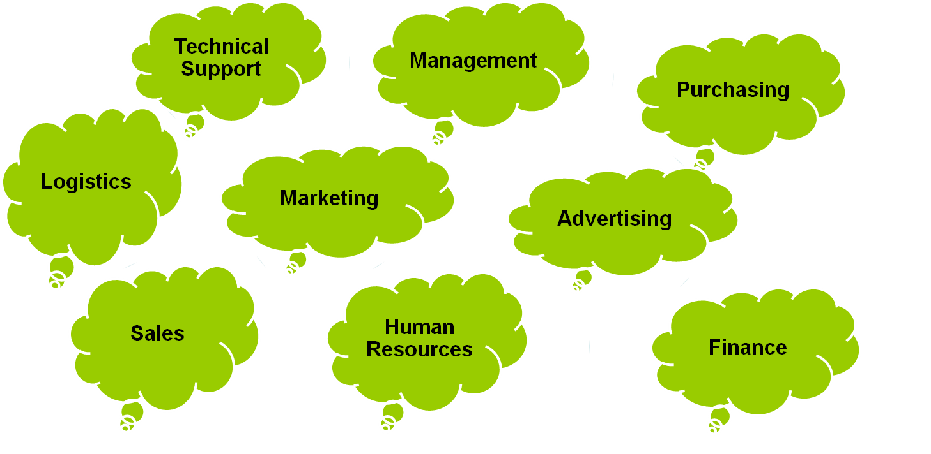
Business Processes

Slide 8
Identifying Application Software - 1
  For each of the business processes that you have identified, suggest at least two types of application software that could be used to perform the tasks needed by each process.

Slide 9
Identifying Application Software - 2
Business Process
Application Software
Advertising
Finance
Human Resources
Logistics
Management
Marketing
Purchasing
Sales
Technical Support
Desktop publishing, graphics
Accounting, spreadsheets
Accounting, database
Scheduling, mapping
Decision making, spreadsheet
Desktop publishing, presentation
Order processing, scheduling
Spreadsheets, word processing
Email, project management

Slide 10
Identifying Good Practice in Software Interface Design
  The user should be able to interact with the interface as easily as possible.
  List some of the features of good software interface design.

Slide 11
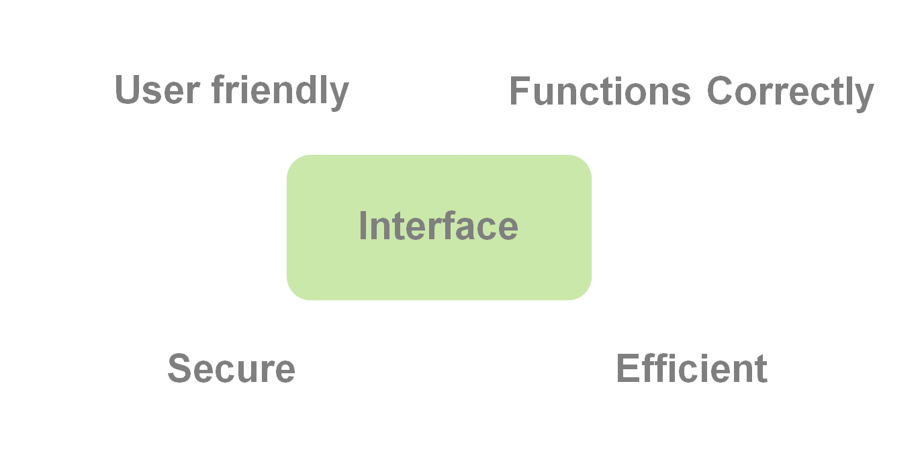
Good Software Interface Design Features

Slide 12
Choosing Advanced Features and Functions of Microsoft Excel
  There are several advanced features and functions in Microsoft Excel that could be used by the Gifts For Everyone! Company.
  List as many as you can.

Slide 13
Excel Advanced Features and Functions
  Financial
  Date and time
  Logical
  Statistical
  Lookup
  Formatting
  Validation
  Macros

Slide 14
Macros in Microsoft Excel
  Macros can automate many tasks and contribute to efficiency when using Microsoft Excel.
  List the tasks that macros could be used for when using spreadsheet software.

Slide 15
Excel Macros
  Data entry
  Data output
  Navigation
  Validation
  Formatting
  Graph work

Slide 16
Choosing Advanced Features and Functions of Microsoft Word
  There are several advanced features and functions in Microsoft Word that could be used by the Gifts For Everyone! Company.
  List as many as you can.

Slide 17
Word Advanced Features and Functions
  Templates
  Formatting
  User forms
  Mail merge
  Validation
  Macros

Slide 18
Macros in Microsoft Word
  Macros can automate many tasks and contribute to efficiency when using Microsoft Word – list the tasks that macros could be used for when using word processing software.

Slide 19
Word Macros
  Data entry
  Data output
  Templates
  Formatting

Slide 20
Software Development Test Plan
  Gifts For Everyone! need to produce a software development test plan. What criteria should they include on the plan?

Slide 21
Software Development Test Plan Criteria
  Test Number
  Description
  Expected Results
  Actual Results
  Test Passed (Date)
  Action Taken
  Test Passed (Date)

Slide 22
Software Development Evaluation Checklist
  Gifts For Everyone! need to produce a software development evaluation checklist. What criteria should they include on the checklist?

Slide 23
Software Development Evaluation Checklist Criteria
  There are several main criteria about which we need to ask questions:
    The type of information provided and presented by the program
    User interaction with the software
    Efficiency, reliability and usability of technical aspects of the software

Slide 24
References - 1
  Business Processes (Topic 1)
  Application Software (Topic 1)
  Software Interface Design (Topic 2)
  Advanced Features and Functions of Microsoft Excel (Topics 3, 4 & 5)
  Macros in Microsoft Excel (Topics 5, 8 & 9)

Slide 25
References - 2
  Advanced Features and Functions of Microsoft Word (Topics 3 & 4)
  Macros in Microsoft Word (Topics 5 & 6)
  Test Plan (Topic 10)
  Evaluation Checklist (Topic 11)
  Also various recommended reading referred to throughout the module

Slide 26
Topic 12 – Combining End User Software Development, Testing and Evaluation
Any Questions?
Notes:
NCC Education - End Slide Master

